Slide 1

Customer Data Science
Stand-up Updates
April 28, 2017

Slide 2




Key updates
BF Discount Sensitivity model
Time to Next Purchase Models BR
Time to Next Purchase Models GP
Click Path Analysis v2
Economic Value of Experience
Gap Inc Confidential – Do Not Distribute or Copy Without Authorization

Slide 3
BF US discount sensitivity model
APRIL 2017
PLATFORM ANALYTICS

Slide 4
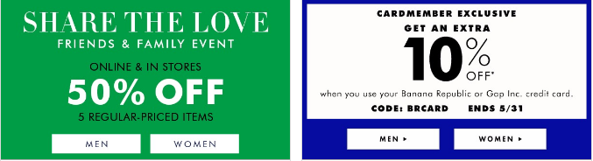

BACKGROUND
Objective:
Every year company shells out billions of $ in various discounts offered.
Not all Customers have affinity towards discounts to make a purchase.
This creates an opportunity to improve margin by offering relevant discounts to customers based on how discount sensitive they are.
The whole exercise will help in:
Increasing Revenue
Saving Cost
Definitions:
Response: customers taking above 35% of gross sales as discounts in an year
Response score: Probability of a customer to search discount above 35% to make purchase
Historical behavior
Response Window
Training
Transactions & Browse Data
Mar2015-Feb2016
Purchase Data
Mar2016-Feb2017
Validation
Transactions & Browse Data
Mar2014-Feb2015
Purchase Data
Mar2015-Feb2016
Algorithms | Library
Ensemble Leaners | xgboost, ada, adabag, gbm, randomForest
Support Vector Machines | kernlab
Logistic Regression
Deep Learning | mxnet, h2o, tensorflow, darch, scikit-learn
Data preparation
Exploratory Analysis
Scaling and Outlier Treatment
Dataset Size involved : 3.3 M (Customer Keys), Response – 3.8%
Model Execution and Testing
Model Evaluation and Validation
Model Training

Slide 5
PREDICTORS AND RELATIVE IMPORTANCE

Slide 6
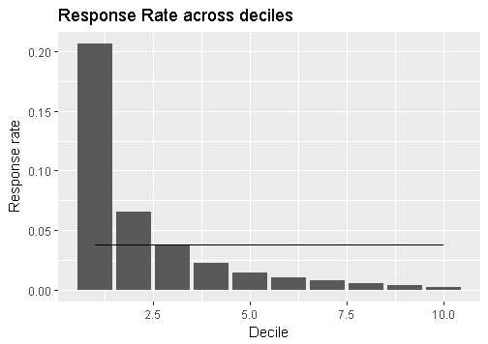
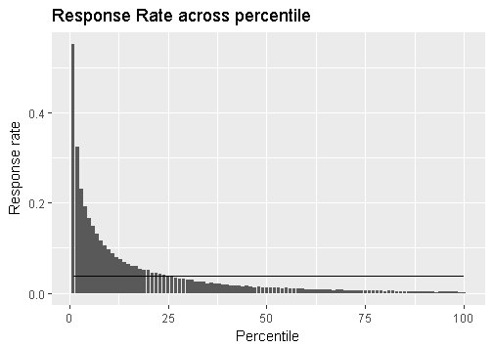
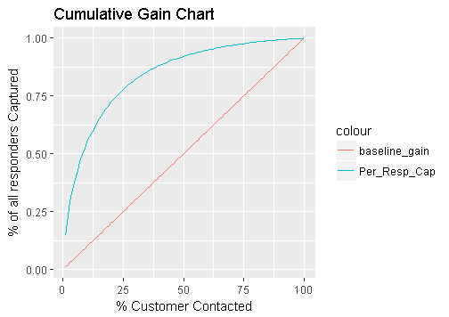
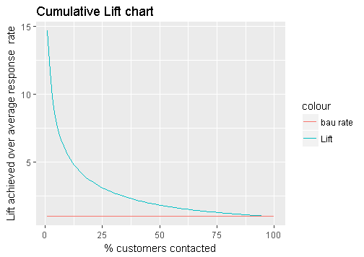
MODEL RESULTS - VALIDATIONS JUL 15-JUN 16
Decile | Number of Customers | Number of Responders | Cumulative Responders | Response Rate | % Responders Captured | Cumulative Response Rate | Cumulative Lift
1 | 334,297 | 68,994 | 68,994 | 20.6% | 54.9% | 20.6% | 5.49
2 | 334,298 | 21,817 | 90,811 | 6.5% | 72.3% | 13.6% | 3.61
3 | 334,297 | 12,429 | 103,240 | 3.7% | 82.2% | 10.3% | 2.74
4 | 334,298 | 7,593 | 110,833 | 2.3% | 88.2% | 8.3% | 2.21
5 | 334,297 | 4,890 | 115,723 | 1.5% | 92.1% | 6.9% | 1.84
6 | 334,298 | 3,515 | 119,238 | 1.1% | 94.9% | 5.9% | 1.58
7 | 334,297 | 2,491 | 121,729 | 0.7% | 96.9% | 5.2% | 1.38
8 | 334,298 | 1,813 | 123,542 | 0.5% | 98.3% | 4.6% | 1.23
9 | 334,297 | 1,324 | 124,866 | 0.4% | 99.4% | 4.2% | 1.10
10 | 334,298 | 783 | 125,649 | 0.2% | 100.0% | 3.8% | 1.00
Model Summary:
Among many models , GBM algorithm was picked based on model performance.
Out of 2000 GBM models, best 20 have been picked and data is scored . Ensemble of median score was taken as final probability which was used for validation
Response Rate across deciles by median score from 20 models
Response Rate across percentiles by median score from 20 models
Cum Gains using median score from 20 models
Cum Lift using median score from 20 models

Slide 7
Economic value of experience
april 2017
PLATFORM ANALYTICS

Slide 8


BACKGROUND
Tracking the impact of customer experience at multiple retail service points
Does late shipment has negative impact on customer behavior
Does customer experience at store impacts future transaction pattern
Does satisfied customers increase their purchase in near future
Scope: BR US
Algorithm: Hypothesis Testing, Comparative Study
Case Study 1: Overall Satisfaction impact on Future Purchase
Case Study 2 : Likelihood to recommend impact on future transactions
Case Study 3: Impact of Cancelled Order on future transaction
Customer Satisfaction
Website Experience
Store Experience
Delivery Experience
Product Experience

Slide 9
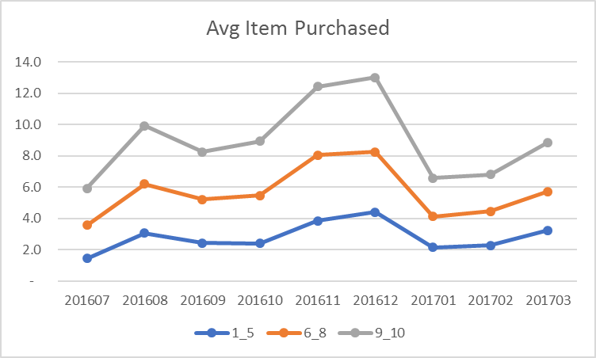
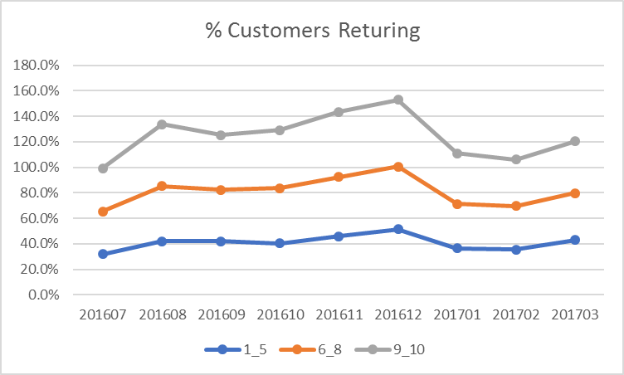
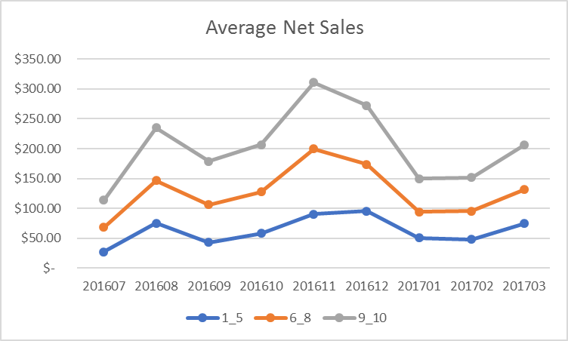
Case Study 1 :Overall Satisfaction impact on Future Purchase
Survey was conducted and customers were asked to rate their overall satisfaction experience in a scale of 1 to 10 (10- Highest)
Next six months behavior have been studied after grouping customers based on satisfaction score

Slide 10
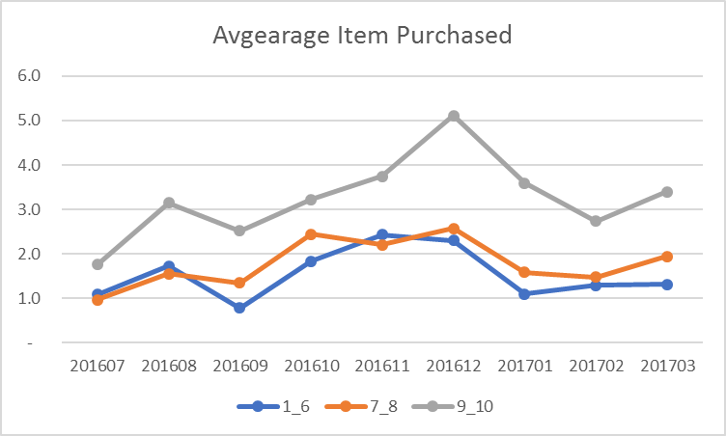
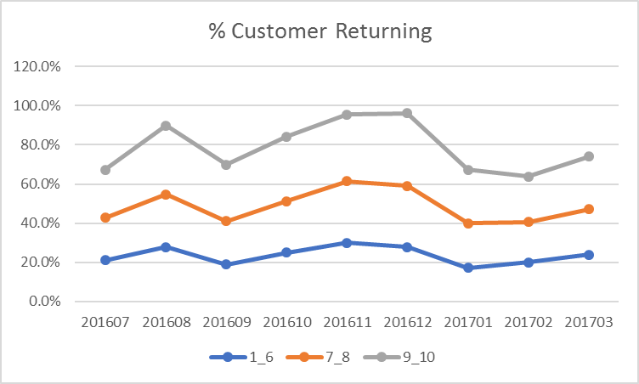
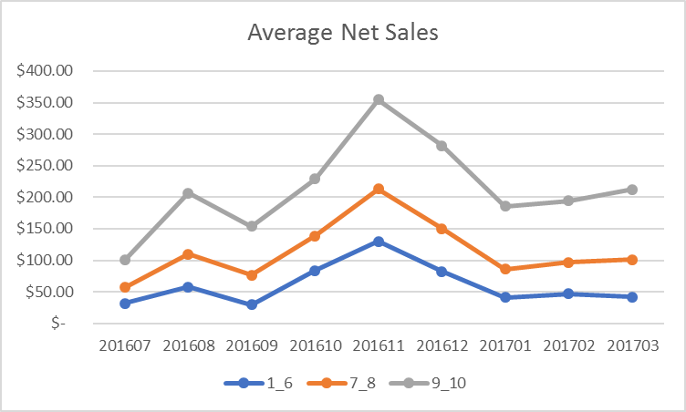
Case Study 2 : Likelihood to recommend impact on future transactions
Survey was conducted and customers were asked to rate their likelihood to recommend to others in a scale of 1 to 10 (10- Highest)
Next six months behavior have been studied after grouping customers based on satisfaction score

Slide 11
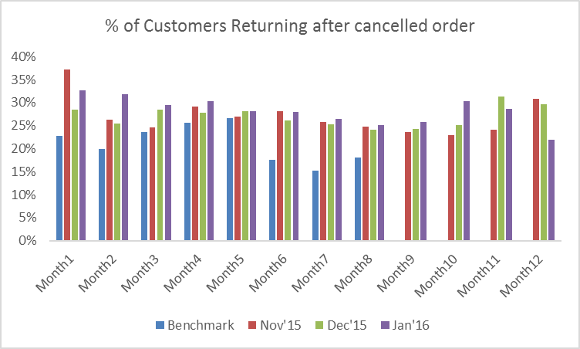
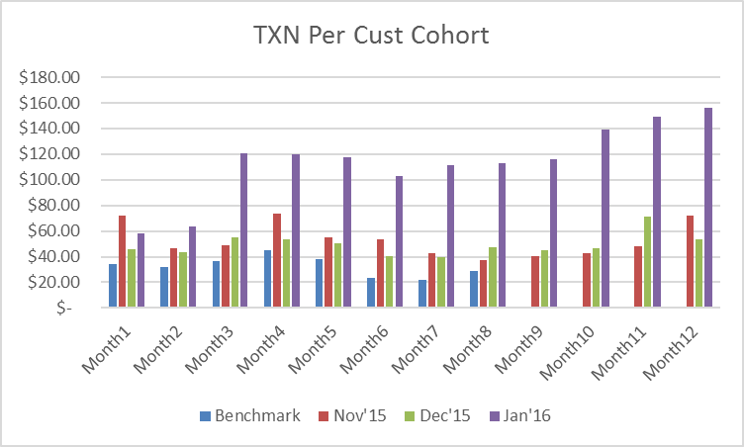
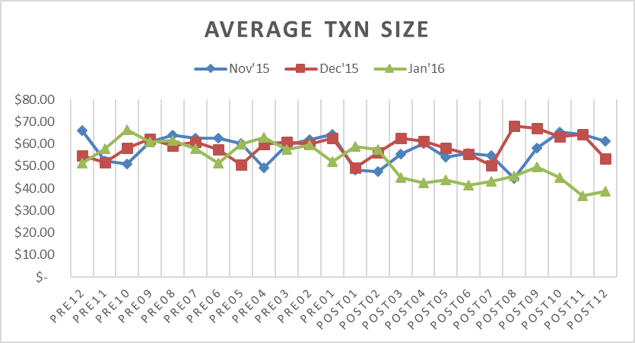
Case Study 3: Impact of Cancelled Order on future transaction
During holiday season because of certain business reason some customers order was cancelled
Analysis was done to understand whether cancelled order has negative impact on customer’s purchase behavior

